Slide 1



AGE, GENDER & EMOTION DETECTION
Group Id:- 4

Slide 2



Team Composition
S.No. | Team Member | SRN | Photo
1. | Rutwik Ganagi | PES1201800627
2. | Harshit Raj | PES1201801364
3. | Akshay Parashar | PES1201801846

Slide 3
Contents
Introduction
Problem Statement
Block Diagram
Literature Review
Work Done
Results
Conclusion
References

Slide 4
Introduction
Automatic gender classification and age estimation from facial image has become an attractive research area in the field of machine learning.
Real and apparent age estimation of human face has attracted increased attention due to its numerous real-world applications like medical diagnosis, etc.
More recently, Deep learning with Convolutional Neural Networks (CNNs) methods have been extensively used for these kind of classification tasks due to their excellent performance in facial analysis.

Slide 5

Problem Statement
To design and implement a deep learning model, capable of detecting Age, Gender and facial Emotion of a person in real-time.

Slide 6
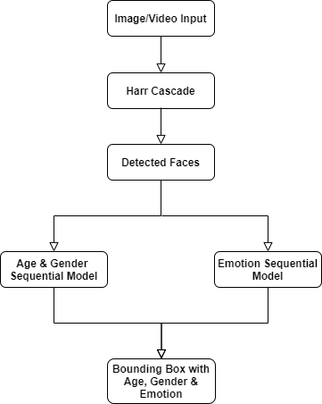
Block Diagram

Slide 7
Literature Review
For our project we have gone through the following papers:
A Gender Recognition System from Facial Image
A Lightweight Convolutional Neural Network for Real and Apparent Age Estimation in Unconstrained Face Images
Deep Learning based approach to detect Customer Age, Gender and Expression in Surveillance Video
Age and Gender Prediction using Deep Convolutional Neural Networks

Slide 8
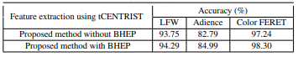
A Gender Recognition System from Facial Image Tawhid, Md. Nurul Ahad & Dey, Emon. (2018). International Journal of Computer Applications.
Problem Statement: Approach for classifying gender from facial images using the feature extraction method named as tCENTRIST.
Methodology: Proposed method for the gender classification task are as follows:
Image Enhancement
Bilateral Histogram Equalization with Pre-processing(BHEP)
Feature Extraction and dimension reduction
tCENTRIST for feature extraction
PCA for dimensionality reduction
Classifier Training
Support Vector Machine(SVM)
Results/Conclusion : Accuracy(%) on different
dataset.
Research Void : A more sophisticated pre-processing method like by applying dynamic size blocks for feature extraction in input images to enhance the pose variation can be applied to improve the accuracies.

Slide 9
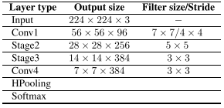
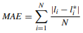
A Lightweight Convolutional Neural Network for Real and Apparent Age Estimation in Unconstrained Face Images O. Agbo-Ajala and S. Viriri, in IEEE Access September,2020
Problem Statement: Designing a lightweight CNN model of fewer layers to estimate the real and apparent age of individuals from unconstrained real-time face images that can be deployed on mobile devices.
Methodology: Proposed method for the age estimation task are as follows:
Face Detection and Alignment
Face Detection
Face Alignment
CNN Lightweight Architecture
Mean Absolute Error (MAE) is the evaluation metric
used in this paper.
Results/Conclusion : Model achieved the best
performance with fewer parameters and a reduction
in computational time which satisfies the real-time requirement of the model for its applicability on mobile devices.
Research Void : There is need to consider a more robust and quality image pre-processing algorithm that detect the unfiltered images faster for real-time estimation of the images.

Slide 10
Deep Learning based approach to detect Customer Age, Gender and Expression in Surveillance Video E. P. Ijjina, G. Kanahasabai and A. S. Joshi (11th International Conference on Computing, Communication and Networking Technologies (ICCCNT), 2020)
Problem Statement: Designing a Deep learning model to detect customer age, gender and expression in surveillance video.
Methodology: The surveillance videos from CCTV cameras in stores is given as input to the proposed framework to detect faces and estimate age, gender and expression of the person. Processes involved are:
Face detection using Haar Cascade object detection model
Age and gender detection using Wide Residual Network architecture
Expression recognition using mini Xception model
Results/Conclusion: 82.9% accuracy rate for gender detection and 70.8% accuracy for age-range.
Research Void: The model has difficulties in detecting the side facial profile of customers not facing the camera, thereby affecting its accuracy. Model is optimized for detecting the age and gender traits of customers belonging to Indian origin.

Slide 11
Age and Gender Prediction using Deep Convolutional Neural Networks Rafique, A. Hamid, S. Naseer, M. Asad, M. Awais and T. Yasir (International Conference on Innovative Computing (ICIC), 2019)
Problem Statement: Designing a deep CNN model to predict age and gender of a person.
Methodology: Deep CNN is used to improve age and gender prediction using HAAR Feature-based Cascade classifiers. Gender classification is done by using neural networks trained on the small set of frontal faces image. It uses 3D structure of head and image intensities for classifying age. The proposed network consists of three convolutional layers in which two of them are fully connected with small number of neurons. Processes involved are:
HAAR Feature-based Cascade Classifiers
Local Binary Pattern (LSB) descriptor
Support Vector Machine (SVM) classifier
Results/Conclusion: Using deep CNN, the accuracy for age and gender prediction is 79%.
Research Void: Over fitting is intensified when considering deep convolutional neural networks due to large parameters, accuracy can be improved by using efficient algorithms and more precise CNN architecture.

Slide 12

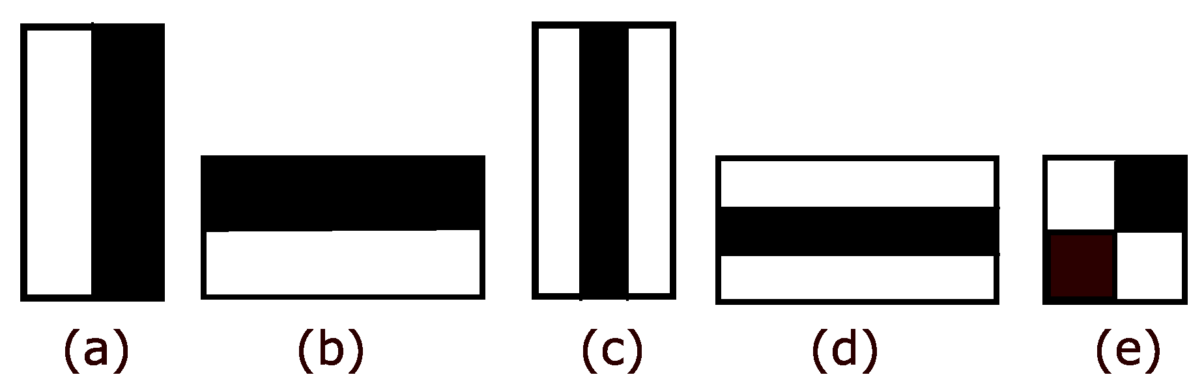
Haar Feature Selection
It is an Object Detection Algorithm used to identify faces in an image or a real time video.
Haar Feature Selection:
(a)&(b) Edge Feature
(c)&(d) Line Feature
(e) Four Rectangle Feature
Creating an Integral Image: To reduce computational time
AdaBoost Training: Selects which haar feature is relevant
Cascading Classifiers: Stage-wise process

Slide 13
Age & Gender Detection Model
Convolutional Neural Network (CNN) is a Deep Learning algorithm which can take in an input image, assign importance (learnable weights and biases) to various aspects/objects in the image and be able to differentiate one from the other.
Model Type: Sequential Model
Convolution Layer No. | No. Of Nodes | Kernel Size
1 | 128 | 3
2 | 128 | 3
3 | 256 | 3
4 | 512 | 3
Convolution Layer No. | No. Of Nodes | Kernel Size
1 | 36 | 3
2 | 64 | 3
3 | 128 | 3
4 | 256 | 3
5 | 512 | 3
Age Model
Gender Model

Slide 14
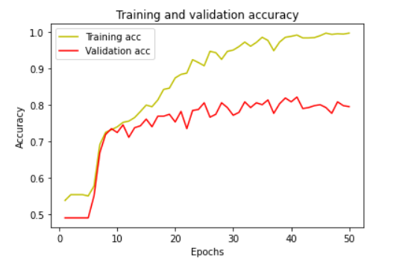
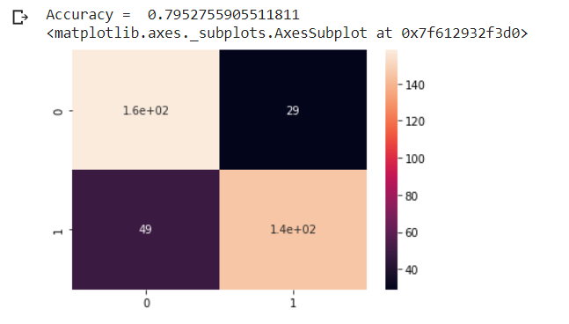
Training & Testing Results
Dataset: 1523 images from UTKFace
Number of epochs: 50
Accuracy: 79.52 %
Fig 1: Training and Validation Accuracy
Fig 2: Confusion Matrix

Slide 15
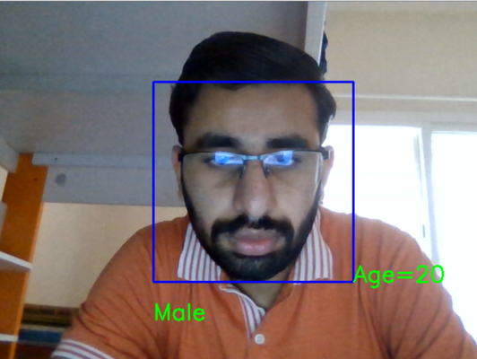
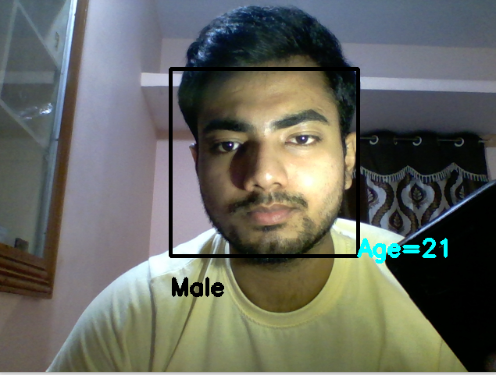
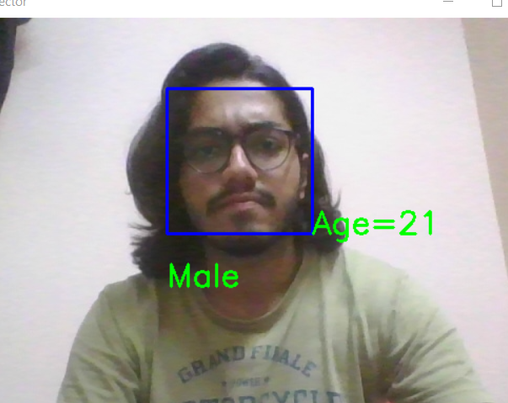
Outputs Obtained

Slide 16
Emotion Detection Model
Four convolution layers have been used:
Activation function used are relu and softmax.
Emotion labels:
['Angry’, ‘Disgust', 'Fear', 'Happy’, 'Neutral’, 'Sad’, 'Surprise’]
Dataset: 4176 images from Kaggle
Test/Train split = 75:25
Convolution Layer No. | No. Of Nodes | Kernel Size
1 | 32 | 3
2 | 64 | 3
3 | 128 | 3
4 | 256 | 3

Slide 17
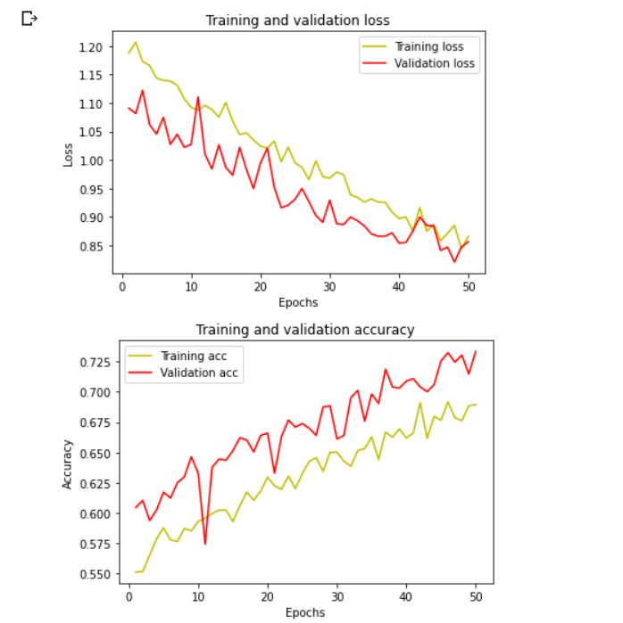
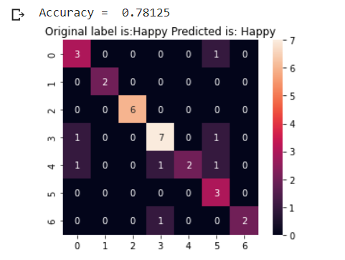
Training & Testing Results
Number of epochs = 50
Accuracy = 78.12%
Fig 3: Training and validation plot
Fig 4: Confusion Matrix

Slide 18
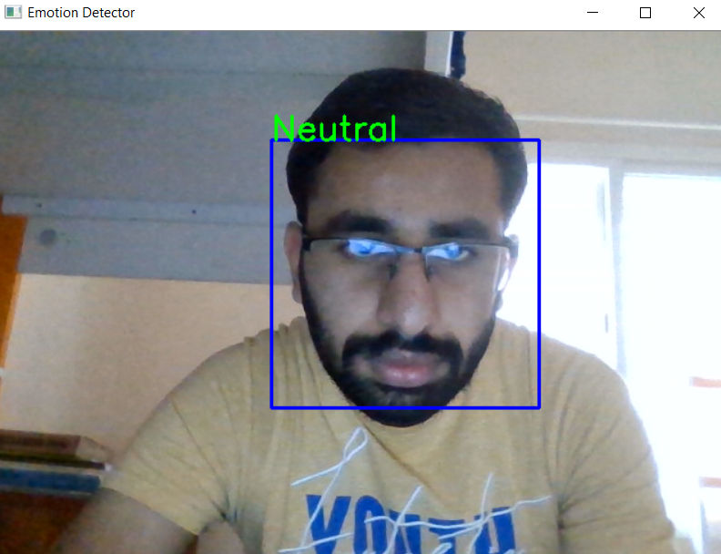
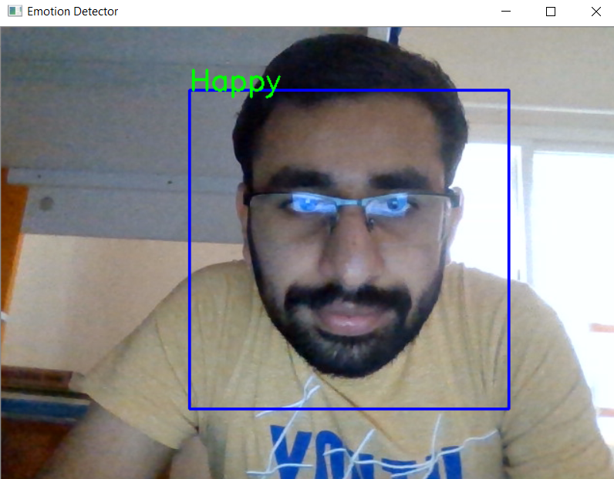
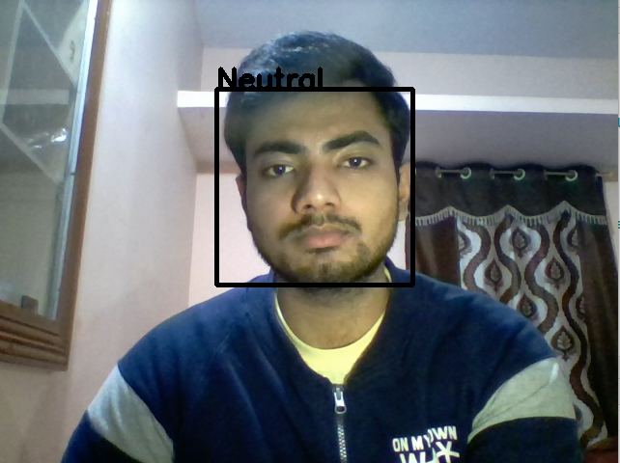

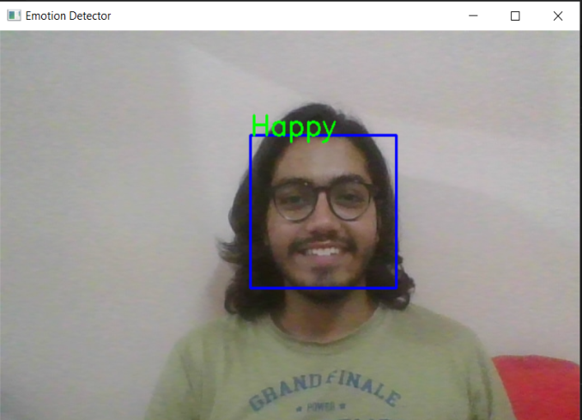
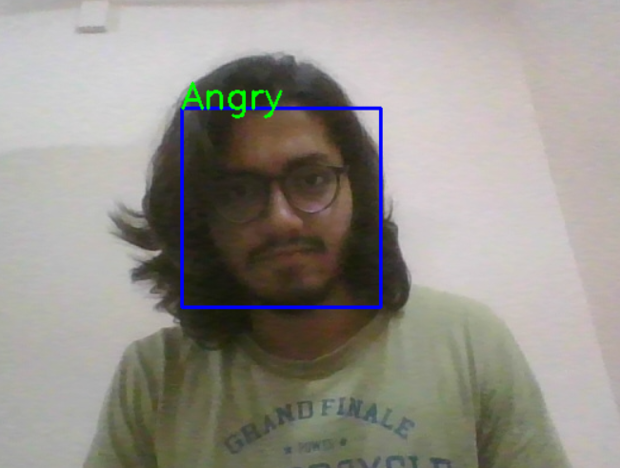
Outputs Obtained

Slide 19
Conclusion
By using deep CNN model we are getting accuracy of 79.52% for Age and Gender detection and accuracy of 78.12% for Emotion Detection.
The accuracy can be further increased by using larger datasets.
Future work would include improving prediction under low lighting conditions and accurate prediction when the person is situated far away from the camera.

Slide 20
References
E. P. Ijjina, G. Kanahasabai and A. S. Joshi, "Deep Learning based approach to detect Customer Age, Gender and Expression in Surveillance Video," 2020 11th International Conference on Computing, Communication and Networking Technologies (ICCCNT), 2020, pp. 1-6, doi: 10.1109/ICCCNT49239.2020.9225459.
I. Rafique, A. Hamid, S. Naseer, M. Asad, M. Awais and T. Yasir, "Age and Gender Prediction using Deep Convolutional Neural Networks," 2019 International Conference on Innovative Computing (ICIC), 2019, pp. 1-6, doi: 10.1109/ICIC48496.2019.8966704.
O. Agbo-Ajala and S. Viriri, "A Lightweight Convolutional Neural Network for Real and Apparent Age Estimation in Unconstrained Face Images," in IEEE Access, vol. 8, pp. 162800-162808, 2020, doi: 10.1109/ACCESS.2020.3022039.
Agbo-Ajala, Olatunbosun & Viriri, Serestina. (2020). Deeply Learned Classifiers for Age and Gender Predictions of Unfiltered Faces. The Scientific World Journal. 2020.
Tawhid, Md. Nurul Ahad & Dey, Emon. (2018). A Gender Recognition System from Facial Image. International Journal of Computer Applications. 180. 5-14. 10.5120/ijca2018915852.

Slide 21
Thank You

